Slide 1
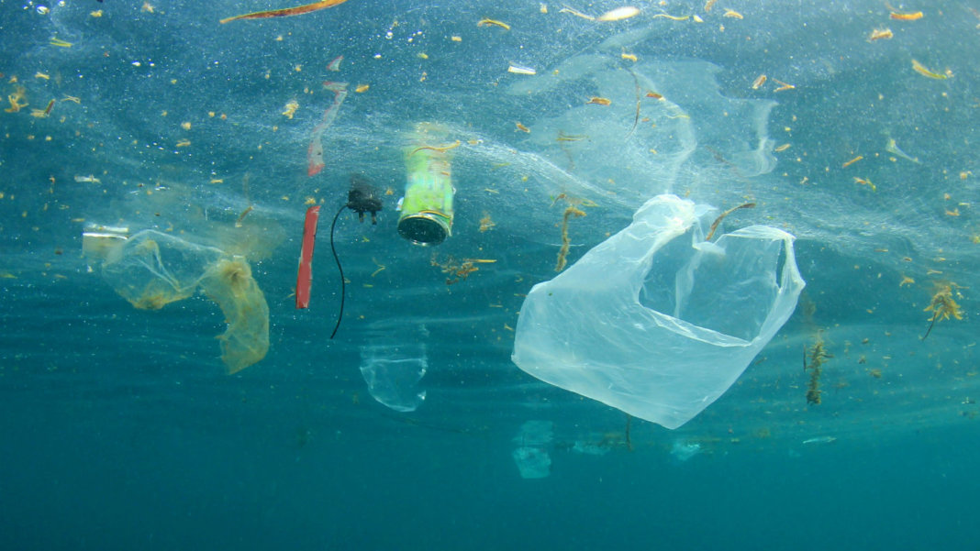

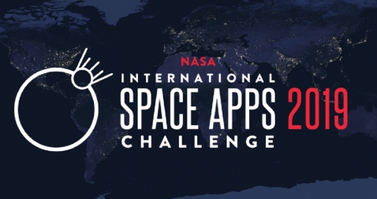

OCLEAN
A bio-inspired solution
to help clean up the ocean
Powered by Kafkoders

Slide 2
INTRODUCTION
Created by @Kafkoders
Help clean the ocean from trash
Ant-robots
Ant Clustering Optimization (ACO) algorithm.
Help to clean and save the world!

Slide 3
PROBLEMATICS
Oceans filled with garbage
The Great Pacific Garbage Patch: largest accumulation of ocean plastic in the world
Between Hawaii and California.
Most extensive analysis ever of this area. Estimated 1.15 to 2.41 million tonnes of plastic
Notes:
more and more everyday. Giving an example, The Great Pacific Garbage Patch is the largest accumulation of ocean plastic in the world and is located between Hawaii and California. Scientists of The Ocean Cleanup have conducted the most extensive analysis ever of this area. It is estimated that 1.15 to 2.41 million tonnes of plastic are entering the ocean each year from rivers. More than half of this plastic is less dense than the water, meaning that it will not sink once it encounters the sea. This is major problem that, not only affects us indirectly, but directly as we are all part of the same earth.

Slide 4
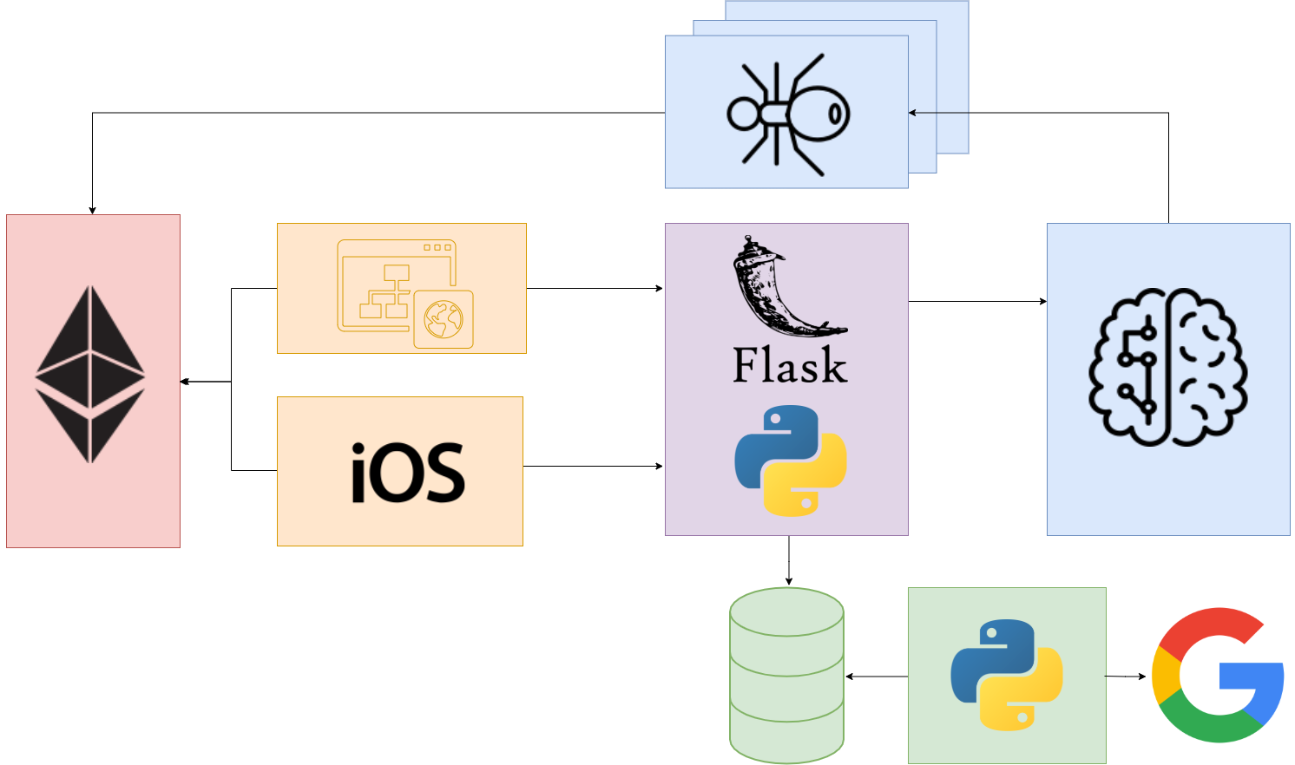
SOLUTION

Slide 5
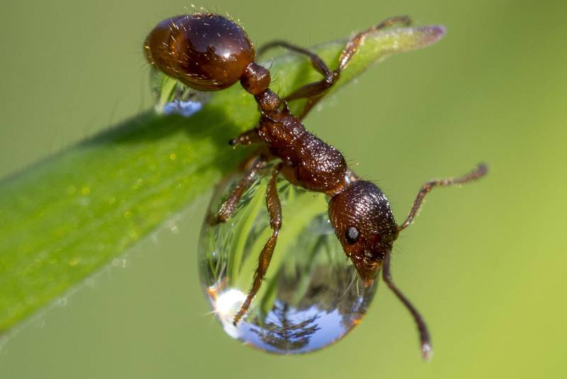
ALGORITHMS
Organize trash
Move trash to specific places.
Advantage of this behavior
Simulate in our robots
Organize ocean litter.

Slide 6
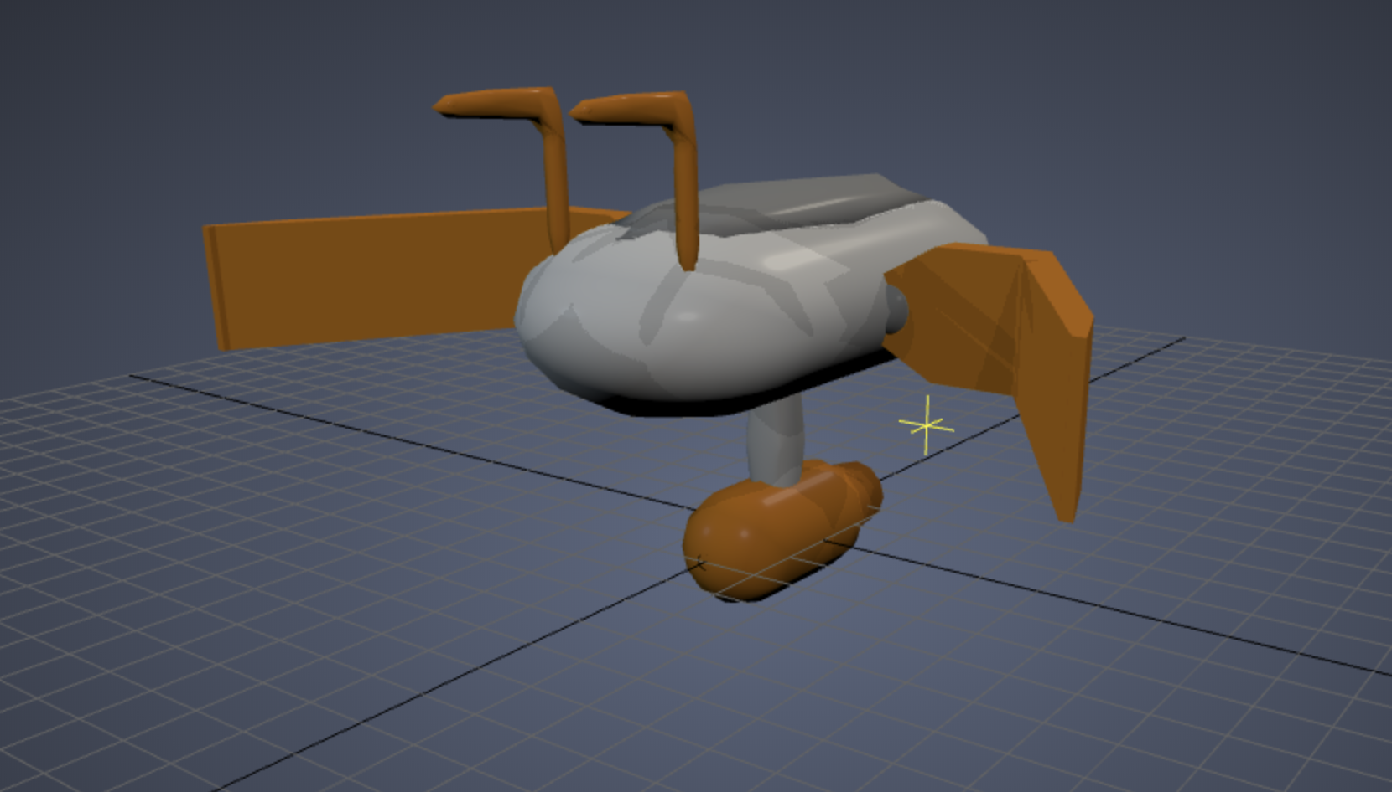
ROBOTS
New smart robots
3 different types of tasks:
AntBoat.
Collector.
Rafts.

Slide 7
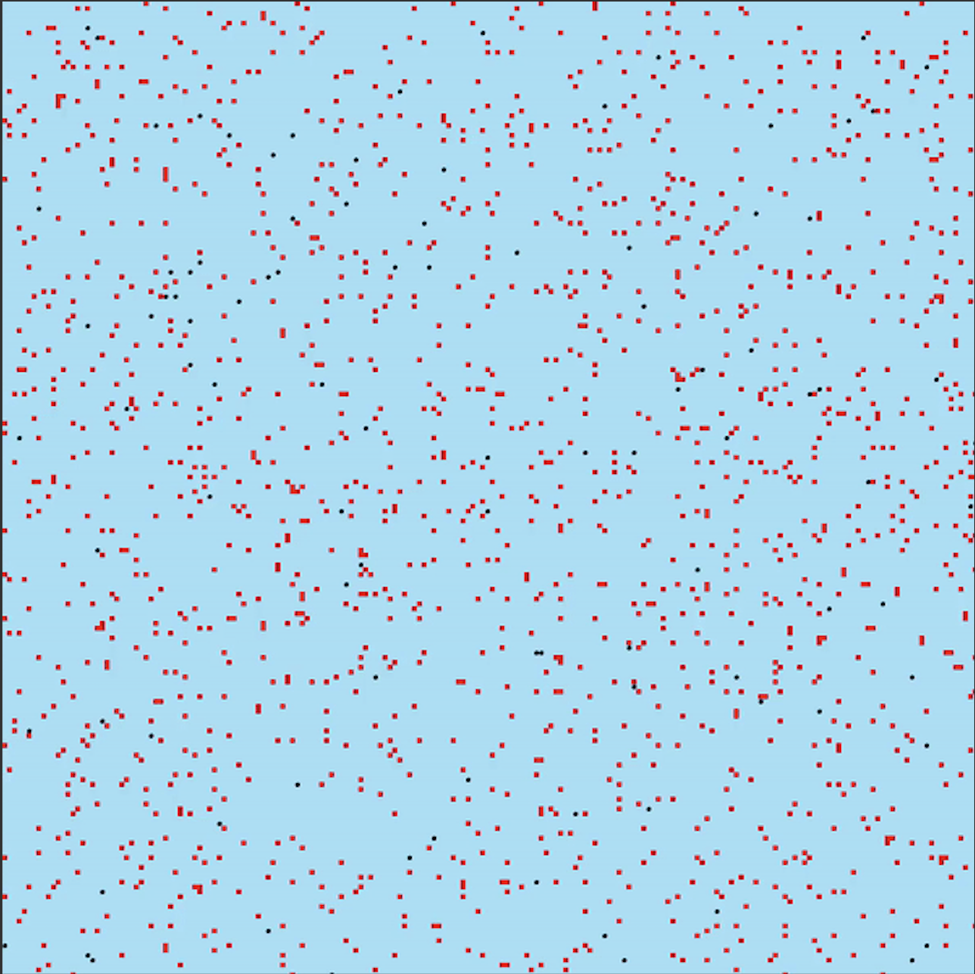
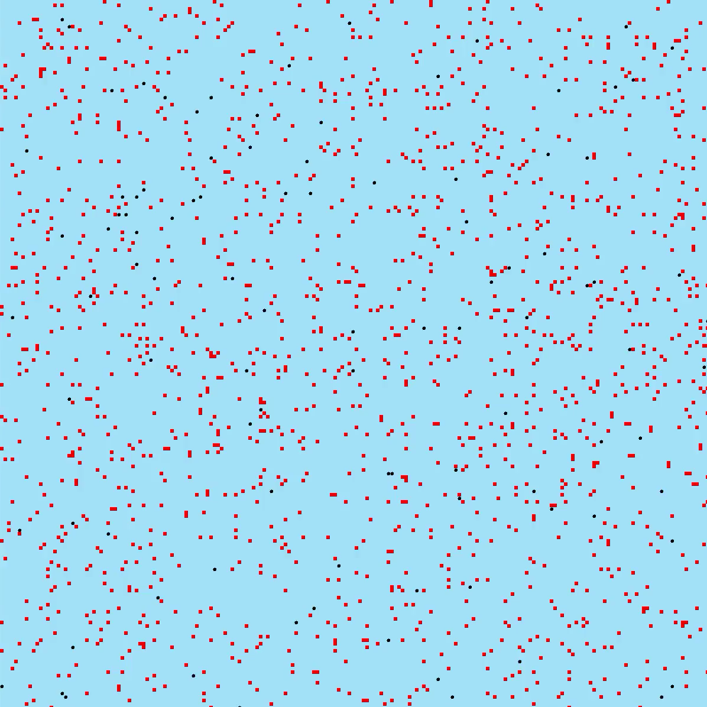
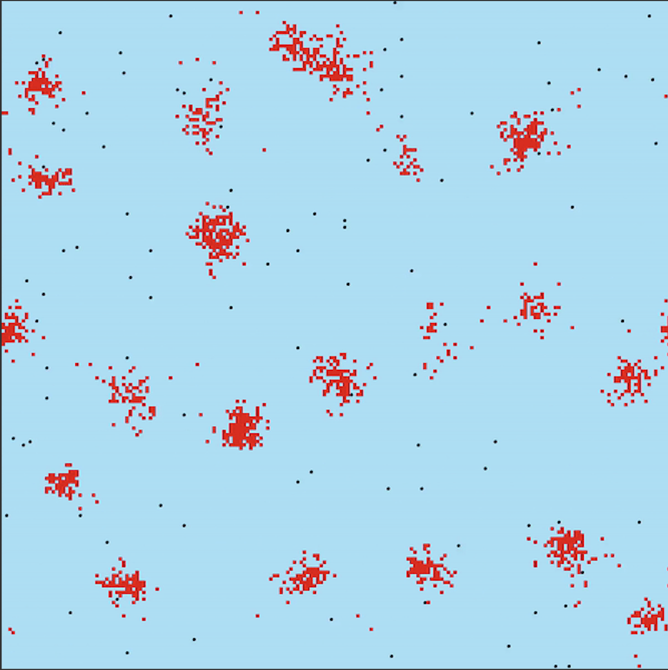
PROCESS

Slide 8
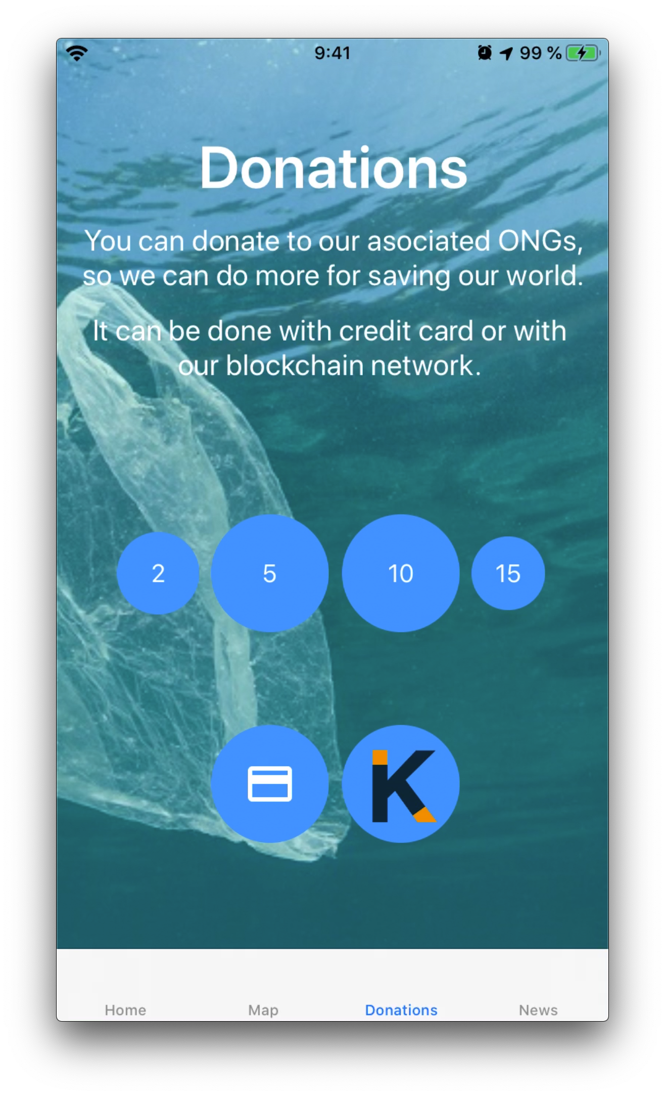
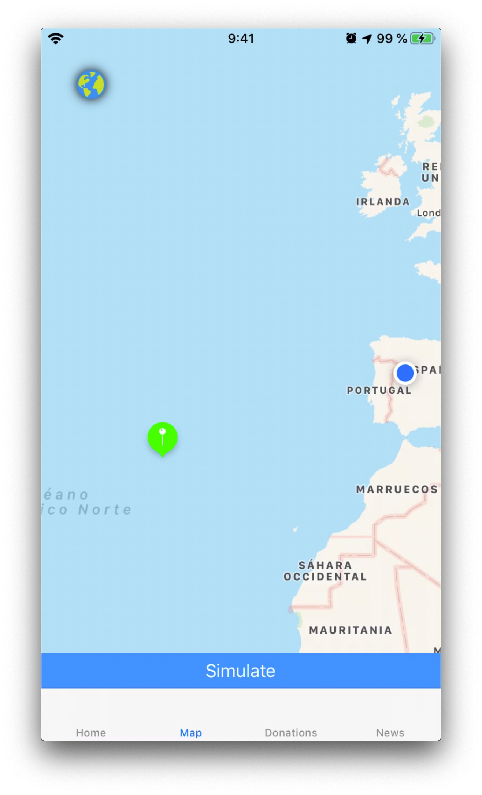
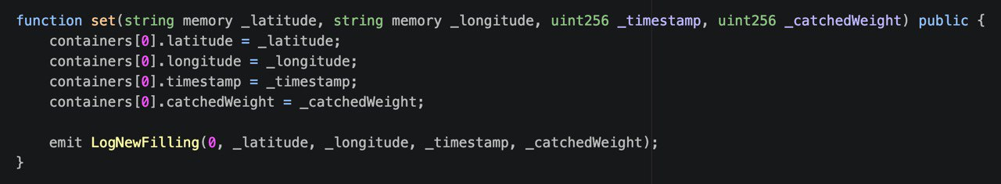
BLOCKCHAIN
Multirobot Model
Scalable
Reliable
Distributed
Donations
Notes:
ROBOTS TIENEN BLOCKCHAIN
CONTRA MALVADAS MULTINACIONALES

Slide 9
BLOCKCHAIN
COIN
Notes:
Token propio
Para poder hacer transacciones dentro de la plataforma
Descentralizado

Slide 10
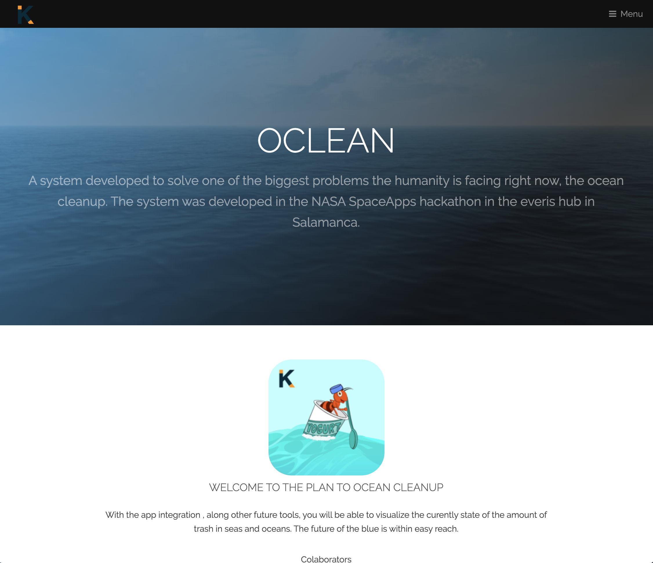
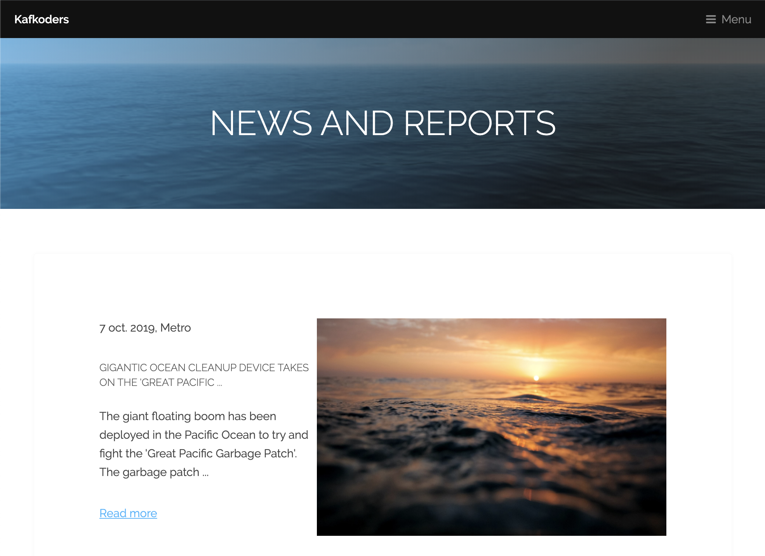
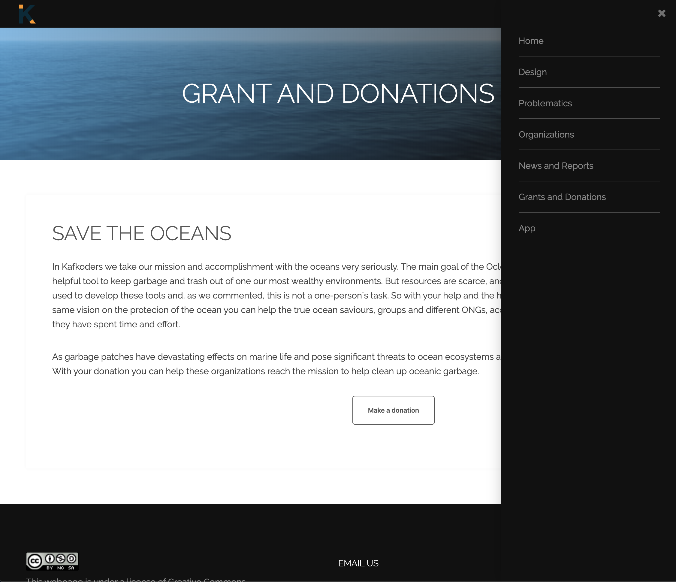
WEB-SITE

Slide 11

APP

Slide 12
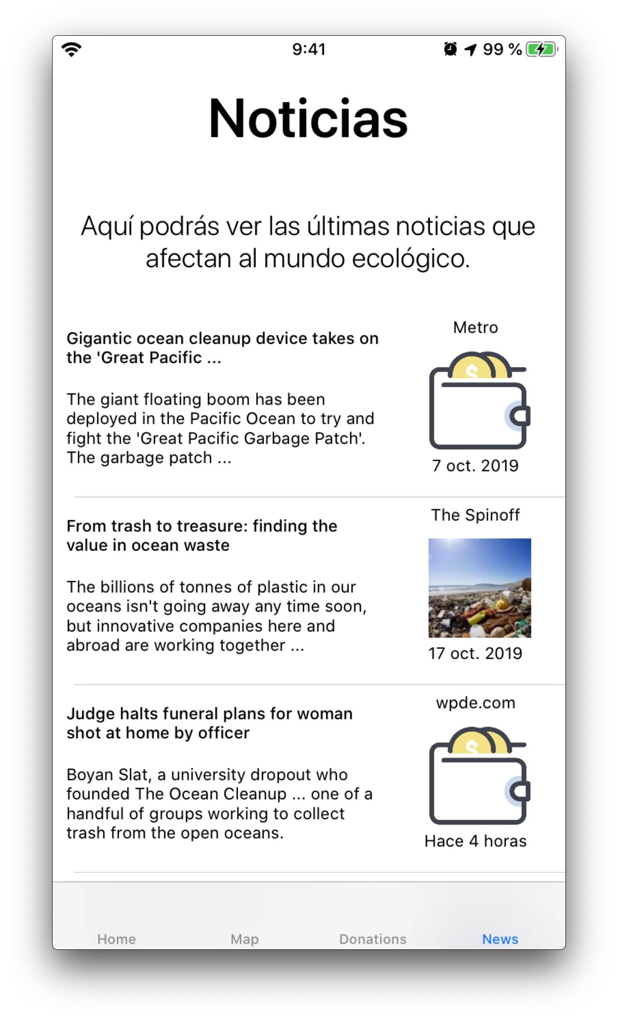
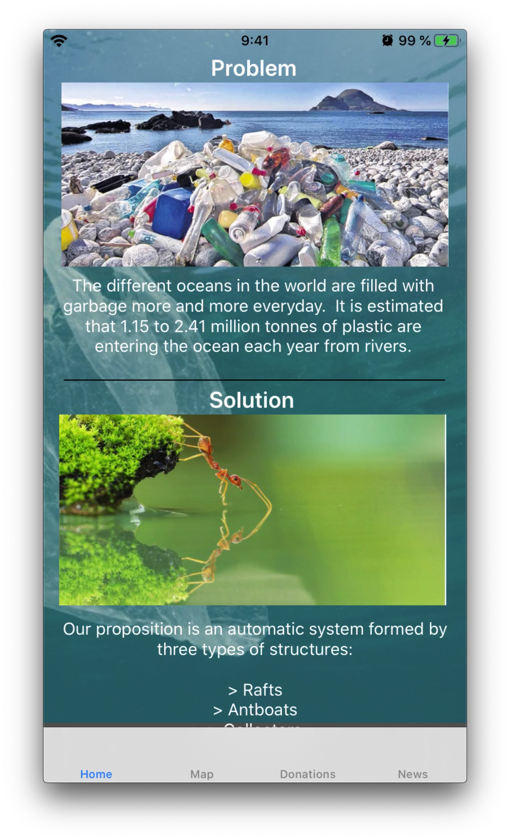
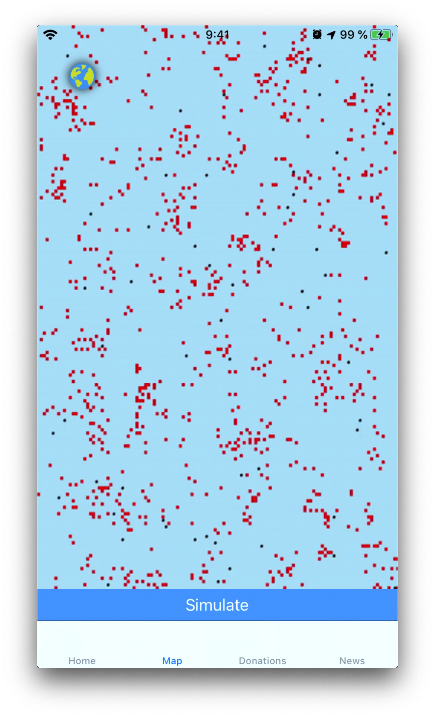
APP

Slide 13
OCLEAN
A bio-inspired solution
to help clean up the ocean
Powered by Kafkoders

